Slide 1

MOVING UPSTREAM
Enhancing our System with Prevention, Early Identification, and Intervention
Date

Slide 2
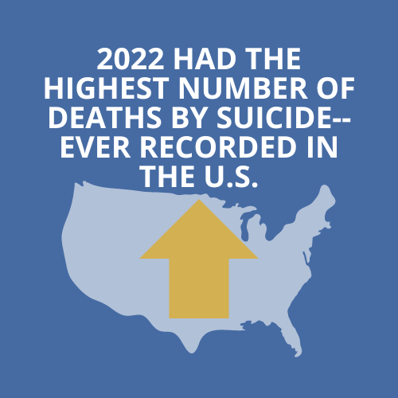
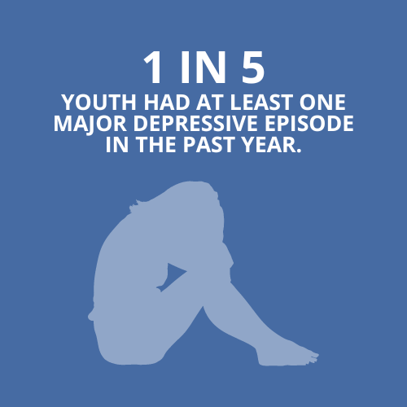
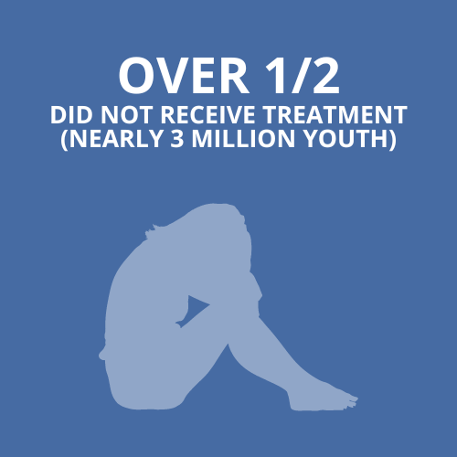
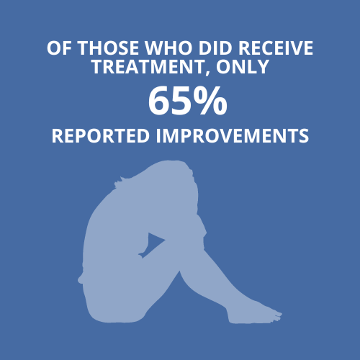

THE NATIONAL STATE OF YOUTH MENTAL HEALTH —2024 REPORT
Reinert, M, Fritze, D & Nguyen, T (July 2024). “The State of Mental Health in America 2024.” Mental Health America, Alexandria VA.

Slide 3
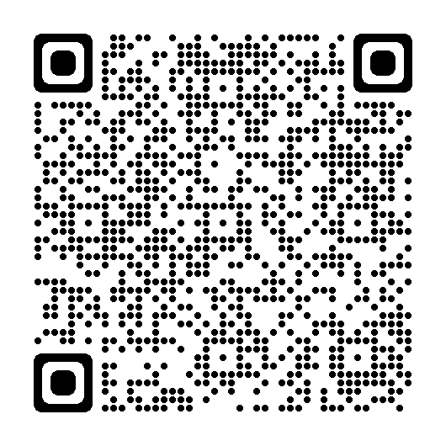
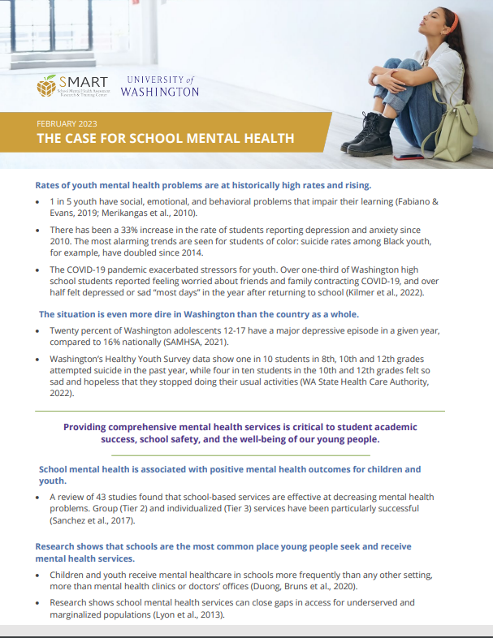
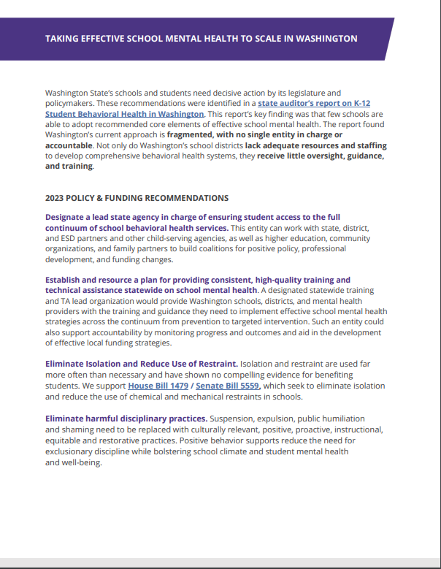
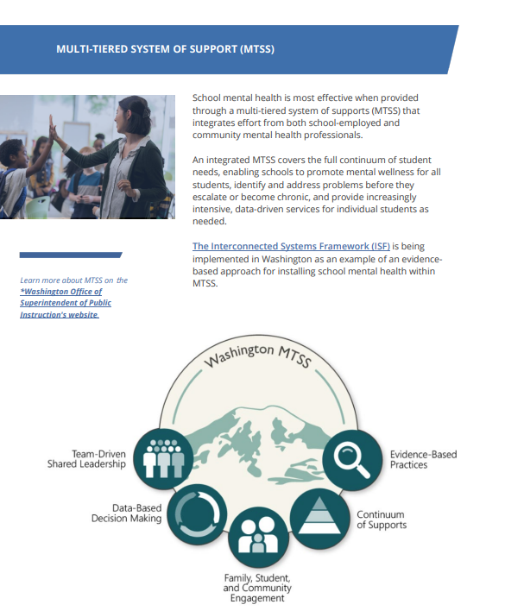
THE CASE FOR SCHOOL MENTAL HEALTH
11
There is an _________ YEAR GAP between onset and treatment of mental health disorders (Wang et.al., 2004)
Youth are more likely to access MH services from ___________than any other settings (Duong et al., 2020)
SCHOOL
School mental health is associated with positive mental health outcomes and decreasing mental health problems through targeted services (Sanchez et.al., 2017)
Research shows that school mental health services can close gaps in access for UNDERSERVED AND MARGINALIZED POPULATIONS (Lyon et al., 2013)

Slide 4
WHAT DO WE KNOW
COVID-19 added to the pre-existing challenges that our youth faced
Mental health is SHAPED BY MANY FACTORS
  SOCIETY (economic inequalities, discrimination, racism, media/technology)
  ENVIRONMENT (safety, food, housing, health care)
  COMMUNITY (relationships with peers/teachers/mentors, school climate, academic rigor)
  FAMILY (relationships with caregivers, family mental health)
  INDIVIDUAL (genetics, race, gender, coping skills)
WE HAVE THE ABILITY TO PROMOTE POSITIVE MENTAL HEALTH AND MITIGATE NEGATIVE OUTCOMES

Slide 5
The state
of youth mental health in (insert district/school)
Source: Add Source & Data in this slide

Slide 6
WHAT IS UNIVERSAL SCREENING?
Proactive procedure for detecting students who may require supports beyond primary (tier 1) prevention efforts at the earliest signs of concern. Systematic screening involves several key features (Lane & Walker, 2015):
  UNIVERSAL: all students attending a school are screened
  REPEATED: fall, winter, and spring each year
  PROACTIVE: used to examine overall level of students’ performance (e.g., internalizing and externalizing behaviors; by district, school, grade, and class levels) and inform decisions about appropriate supports for students with relevant secondary (Tier 2) and tertiary (Tier 3) needs
  PSYCHOMETRICALLY SOUND: reliable and valid for the intended population
Lane, K.L., Powers, L., Oakes, W.P., Buckman, M.M., Sherod, R., & Lane, K.S. (April 2020). Universal Screening – Systematic Screening to Shape Instruction: Lessons Learned & Practicalities. Eugene, OR: Center on PBIS, University of Oregon. Retrieved from www.pbis.org.

Slide 7
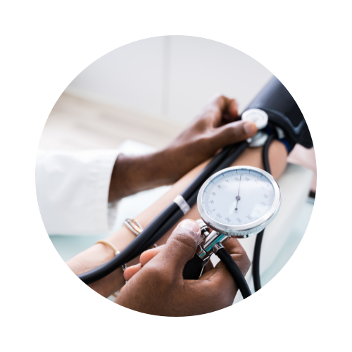
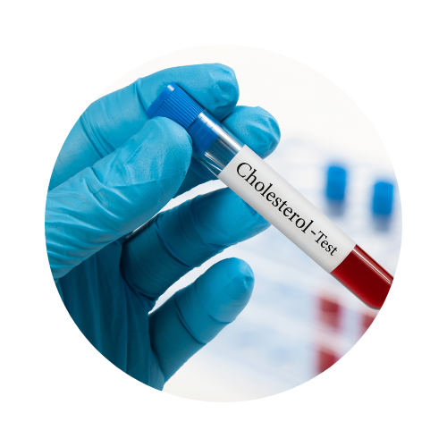
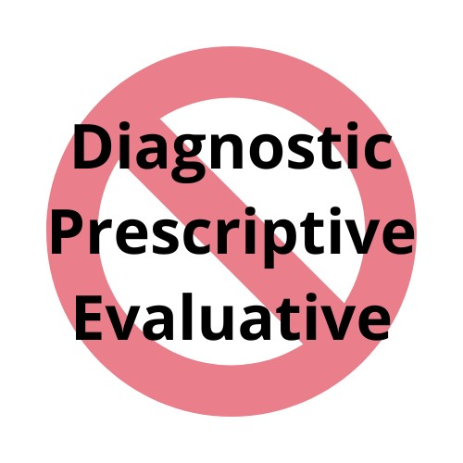
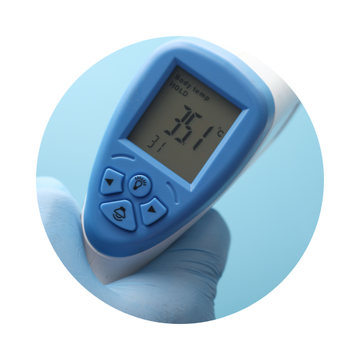
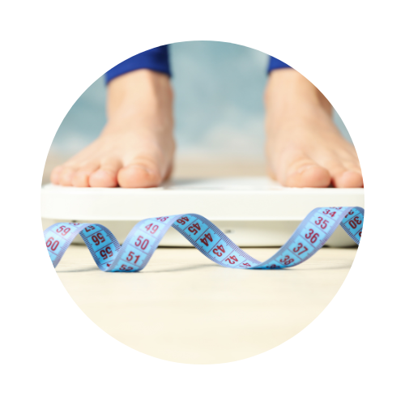
What Is Universal Screening?

Slide 8
“Mental health screening is NOT A PRODUCT, but rather A PROCESS for identifying students at risk of developing mental and behavioral health challenges.”
Twyford, J., Eklund, K., Chin, J. & Dowdy, E. March 2010. “Behavioral RTI Model: Implementing Screening for Emotional and Behavioral Problems.” Mini-session presented at the meeting of the National Association of School Psychologists, Chicago IL.

Slide 9
WHAT IS COMPREHENSIVE MENTAL HEALTH
How do we determine what we screen for?

Slide 10
mental health continuum
Concerning Indicators (SEB Problems)
Positive Indicators (SEB Wellness)
SYMPTOMS
Anxiety, Depression, Other Internalizing Problems
Disruptive Behaviors (defiance, rule violations, substance use)
Life Satisfaction & Happiness
Strong Social Relationships
Trauma and other environmental stressors
Thinking errors, behavioral withdrawal
Risky/Unsafe settings
Inconsistent rules and expectations across settings
Building blocks of well-being (gratitude, empathy, persistence)
Basic Needs are Met
Social Skills
Healthy Interactions (minimal bullying, high support)
Risk Factors
Protective/Promotive Factors

Slide 11
mental health continuum
Concerning Indicators (SEB Problems)
Positive Indicators (SEB Wellness)
Anxiety, Depression, Other Internalizing Problems
Disruptive Behaviors (defiance, rule violations, substance use)
Life Satisfaction & Happiness
Strong Social Relationships
Trauma and other environmental stressors
Thinking errors, behavioral withdrawal
Risky/Unsafe settings
Inconsistent rules and expectations across settings
Building blocks of well-being (gratitude, empathy, persistence)
Basic Needs are Met
Social Skills
Healthy Interactions (minimal bullying, high support)
Risk Factors
Promotive/Protective Factors
PREVENT, REDUCE, AND MANAGE RISK FACTORS
Identify students at-risk
Provide targeted interventions matched to signs of risk and needs
Provide support to youth in crisis or with chronic mental health needs
FOSTER PROTECTIVE FACTORS
Teach social, emotional, and behavioral skills
Create safe and nurturing environments that support well-being for ALL
Foster resilience and increase protective factors for ALL

Slide 12
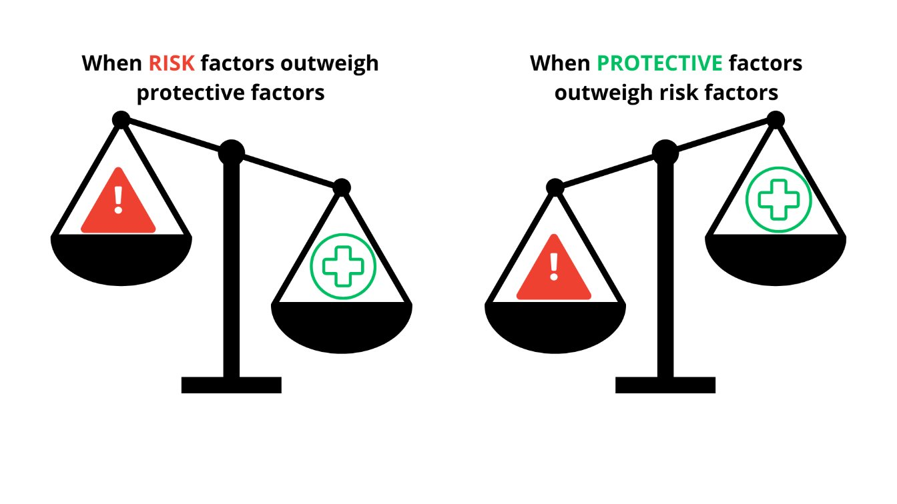
WHAT IS SEB-MH RISK?
Youth is likely to be at a DISADVANTAGE
Youth is likely to be RESILIENT

Slide 13
WHAT IS UNIVERSAL SCREENING?
Proactive procedure for detecting students who may require supports beyond primary (tier 1) prevention efforts at the earliest signs of concern. Systematic screening involves several key features (Lane & Walker, 2015):
  Universal: all students attending a school are screened
  Repeated: fall, winter, and spring each year
  Proactive: used to examine overall level of students’ performance (e.g, internalizing and externalizing behaviors; by district, school, grade, and class levels) and inform decisions about appropriate supports for students with relevant secondary (Tier 2) and tertiary (Tier 3) needs
  Psychometrically sound: reliable and valid for the intended population
Lane, K.L., Powers, L., Oakes, W.P., Buckman, M.M., Sherod, R., & Lane, K.S. (April 2020). Universal Screening – Systematic Screening to Shape Instruction: Lessons Learned & Practicalities. Eugene, OR: Center on PBIS, University of Oregon. Retrieved from www.pbis.org.

Slide 14
TRADITIONAL DETECTION METHODS
REACTIVE
  The longer the problem goes undetected, the more complex the intervention
BIAS
OVER-identification of EXTERNALIZING behaviors
UNDER-identification of INTERNALIZING behaviors

Slide 15
Why Screen?
Enhance comprehensive continuums of support
Identify students’ strengths and needs
Improve access to and benefit from mental health services
Make economically sound decisions
Prevention and early intervention

Slide 16
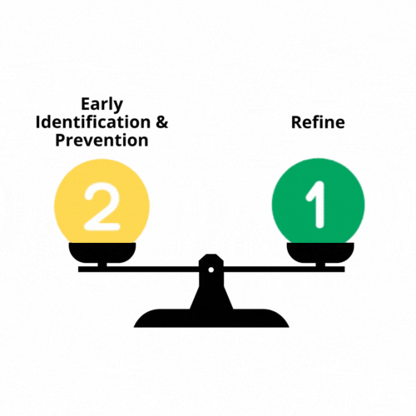
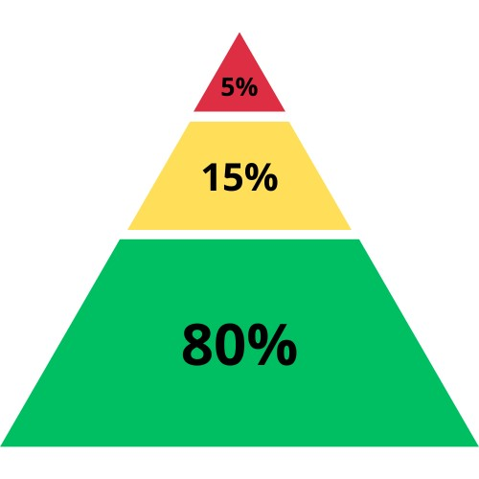
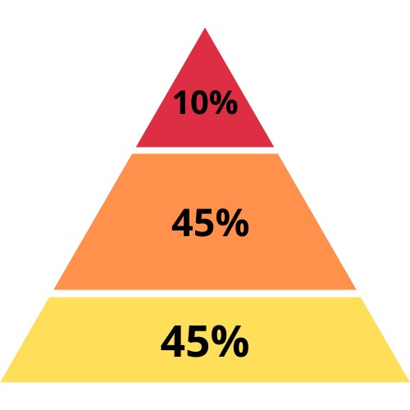
WHAT CAN WE LEARN FROM A UNIVERSAL SCREENER?
To what extent is our Tier 1 supporting all students?

Slide 17
SCREENING V. ASSESSMENT
UNIVERSAL SEB-MH SCREENING
SEL ASSESSMENT
TARGETED
Screen for early signs of psychological problems, as well as the presence of resilience factors and indicators of wellbeing.
(Romer et al., 2020).
Assessing the quality of students’ SEL competencies (e.g. Interpersonal and intrapersonal knowledge, skills, attitudes, and mindsets) to guide instructional practice.
(Mckown 2020; casel assessment workgroup 2018).
Evaluating the behavior/abilities (e.g. Anxiety, depression, substance abuse, suicide) for making a diagnosis/ treatment recommendations.
(APA, 2020)

Slide 18



Who completes the screener?

Slide 19
Overview of screening tool
Insert slides that give stakeholders an intro and overview to the screening tool and process you’re using.
This will be contextual based on the screening tool you select.

Slide 20
NEXT sTEPS
Field Test #1
Screening Windows for first round of screening here.
Field Test #2
Screening Windows for second round of screening here.
Implementation Plan
Multi-phase plan beginning in…insert dates

Slide 21
3 Key Points
(or New Learnings)
REFLECTION
What squared with your thinking?
What questions may still be circling?

Slide 22
Questions?

