Slide 1
Missing Data and Multiple Imputation
SMARTstats Workshop Series · UW SMART Center & HIPRC
Keith Hullenaar, PhD
Notes:
50 minutes of concepts, then 30 minutes in RStudio. No code on these slides - the code lives in the demo and on the cheat sheet.

Slide 2
HOW THE SESSION RUNS
Four parts
10 min
The problem
Why data go missing, and why it matters more than "we had x% missing"
10 min
Multiple imputation
What it is, why it works, and what it cannot do
10 min
Clustering
Why nested data changes the answer — and why this is the part our fields get wrong
50 min
RStudio
All of the above, on real code, with one decision you get to make
Notes:
Set expectations: the first 50 minutes have no code at all. Tell them the cheat sheet has every command they will need.

Slide 3
The problem
Why data go missing, and what we do about it

Slide 4
THE RUNNING EXAMPLE
Does a school’s victimization climate affect student mental health?
Students
nested in schools — clustering is the rule in our fields, not the exception
Victimization
a sensitive self-report item, and heavily skipped
School climate
comes from a separate administrator survey on school victimization, some schools never return the survey
MH outcome
Symptomatic students may be less likely to answer the items
Roughly a quarter of middle schoolers report being bullied, and the rate is higher for girls than boys.
Notes:
NCES/BJS School Crime Supplement: middle school 26.3% vs high school 15.7%; girls 21.8% vs boys 16.7%. Note this is a lagged association, not a causal effect - say it once and move on.

Slide 5
WHY THIS IS NOT JUST A SAMPLE-SIZE PROBLEM
Missing data cost you two different things
Power
Bias
You have fewer observations than you collected. Wider intervals, less ability to detect what is really there.
The people who remain are not the people who left. Your estimate moves — and you cannot tell which direction.
This one is obvious, and it is the smaller problem.
This one is invisible, and it is the one that ends up in print.
Notes:
Most people arrive thinking of missing data as a power problem. The whole session hinges on shifting that.

Slide 6
THE DEFAULT
Your software already made a decision for you
Many statistical packages, faced with a missing value, deletes the entire case — silently, and without telling you how many it dropped.
It is a model
Deletion assumes the people who stayed are exchangeable with the people who left. That is a heroic empirical claim.
It is unstated
Nothing in your default output says this is okay to do. No diagnostic, no warning, no line in the results table.
It is usually wrong
It holds only when data are missing for reasons unrelated to anything you measured — which is rare.
Notes:
The point is not that deletion is always wrong. It is that using it by default means you never made the choice.

Slide 7
A YARDSTICK
Three things any missing-data method must do
1
2
3
Minimise bias
Use the information you have
Tell the truth about uncertainty
Keep your estimates as close to the truth as the data allow.
You have those partial records. Do not throw them away.
Standard errors and intervals that reflect what you did — and did not — observe.
Notes:
This framing is Allison’s and it is still the best available for a mixed audience.

Slide 8
THE QUESTION THAT DETERMINES EVERYTHING
Why are these data missing?
Three answers that are nearly untestable assumptions.
MCAR
Missing completely at random
The reason has nothing to do with anything. The missing process was completely random.
MAR
Missing at random
The reason is something you measured, and once we account for it, the missingness is random. Students with poor attendance skip the spring survey — and you have attendance measures.
MNAR
Missing not at random
The reason is the missing value itself, or it’s not observed in the data. E.g., the students who fight the most are the least likely to answer the question about fighting. E.g., we have no information that explains the missingness.
Notes:
Spend time here. Everything downstream depends on the audience holding these three apart.

Slide 9
THE THREE AT A GLANCE
What each mechanism costs you
 | Can you test it? | Is deletion safe? | Does imputation help?
MCAR | Partly | Unbiased, but wasteful | Yes — and more power
MAR | No | No | Yes
MNAR | No | No | Reduces bias; does not remove it
Almost all real data are somewhere between MAR and MNAR.
Which means the question is never "is deletion safe?" — it is "how much can I do to make the assumption I need as plausible as possible?"
Notes:
Resist the urge to let people file their dataset into one box. The boxes are idealisations.

Slide 10
THE MOST IMPORTANT IDEA IN THIS SESSION
"Missing at random" is a property of your model,
not of your data
Your data are not MAR or not-MAR. A given ANALYSIS is, depending on what you chose to condition on.
If we are missing victimization exposure…
Condition on nothing
Missingness looks arbitrary, but isn’t. You are in the worst case.
Condition on attendance
Now, part of why the outcome is missing is explained. You have moved toward MAR.
Condition on attendance and teacher ratings
More of it is explained. The assumption you need has become more defensible. We can probably do even better!
Notes:
If they leave with one idea, make it this one. It reframes MAR from a fact you check to a target you work toward.

Slide 11
A HABIT WORTH BREAKING
You cannot test your way out of this
One possible workflow
Why none of it follows
Run a statistical test of MCAR (e.g., correlation between variables and missingness)
Fail to reject it
Conclude the data are fine
Delete and move on
Report nothing
Failing to reject is not evidence in favour —it can be due to low statistical power.
Imputation is appropriate under MCAR anyway, and more efficient than deletion.
The test says nothing about MAR versus MNAR — the distinction that matters.
No test result licenses deletion. In modern applied statistics, multiple imputation is expected unless it is impossible (e.g., you are running a REALLY complicated model with which MI is incompatible)
Argue for your mechanism from how the data were collected — and write the argument down where a reviewer can see it.
Notes:
Expect pushback from someone who reports this test routinely. The point is not that it is invalid - it is that no result it can produce changes what you should do.

Slide 12
SCORING THE USUAL SUSPECTS
Why the conventional fixes fail
Method | Bias | Uses the data | Honest uncertainty
Listwise deletion (delete the case) | Only safe under MCAR | Terrible | Yes
Pairwise deletion | Only safe under MCAR | Better | No — no honest SE
Mean substitution | Biased, even under MCAR | Yes | No — shrinks variance
Missing-indicator / dummy adjustment | Biased, even under MCAR | Yes | Roughly
Single regression imputation | Better | Yes | No — far too confident
Deletion is at least honest about what it does not know. Single imputation is the dangerous one — it hands your software a guess and lets it report the standard error as though you had measured it.
Notes:
Allison’s verdict, and it still holds: conventional imputation is more dangerous than deletion because it hides the damage.

Slide 13
Multiple imputation
What it is, why it works, and what it cannot do

Slide 14
INTUITION BEFORE FORMALISM
The core idea in three moves
1
2
3
Draw
→
Analyse
→
Pool
Run your ordinary analysis on each completed dataset. Unchanged. The model you already wanted to fit.
Combine the answers so that the disagreement between them becomes part of your reported uncertainty.
Fill each missing value several times over, drawing plausible values from everything else you know about that case — with random noise, using modeling, so the fills differ.
You are not recovering the values that went missing. You are recovering the RELATIONSHIPS those values would have contributed to..
Notes:
The last line is worth saying slowly. It pre-empts the "making data up" objection two slides early.

Slide 15
WHY NOT JUST FILL EACH GAP ONCE?
The random noise is the whole trick
Fill it once
Fill it many times
Your software cannot tell a real value from a guess. It computes the standard error as though you had observed everything.
Each completed dataset gives a slightly different answer. That spread is a measurement of how much the missing data cost you.
Confidence intervals too narrow. p-values too small. You will be more certain than you have the right to be.
The disagreement between fills becomes the extra uncertainty you owe the reader.
This is the single reason the method is called MULTIPLE imputation, and it is the reason it works when older imputation methods did not.
Notes:
Single imputation is not a cheaper version of MI. It is a different method with a known defect.

Slide 16
THE FORMALISM — ONE SLIDE
How the answers get combined in Multiple Imputation
Total uncertainty = what the analysis would have cost anyway + what the missingness added
Within
Between
Fraction of missing information
Average the squared standard errors across the completed datasets. This is the ordinary cost of estimating anything.
How much the estimate moves from one completed dataset to the next. This is the price of not having observed the data.
The share of your total uncertainty that comes from missingness. It is the number that tells you how many times to repeat the whole process.
One rule you cannot break: pool the estimates and their variances. We have to calculate using Rubin’s Rules (in the package)
Never average test statistics — not t, not z, not chi-square, not F.
Notes:
One slide of notation, not five. The algebra belongs in the readings; the intuition belongs here.

Slide 17
THE RULE THAT CATCHES PEOPLE
The imputation model has to be at least as rich
as the model you are going to fit
This is called congeniality, and violating it is the most common way a careful analysis goes wrong.
If your analysis... | ...but your imputation model... | Then
treats a variable as categorical | treats it as continuous | Biased
includes an interaction or a curve | is strictly linear | Biased
has a random intercept for school | ignores the clustering | Biased (see later)
Trouble comes when the imputation model is SIMPLER than the analysis model.
The reverse is usually harmless — so when in doubt, build a rich imputation model.
Notes:
Flag that when the imputer and the analyst are different people, this is where projects fall apart.

Slide 18
HOW YOU EARN THE ASSUMPTION
Auxiliary variables
Variables that help explain missingness, but are not part of the model you want to report.
In our data
Practical limits
Fall attendance rate
Teacher-rated peer relations
Both predict who goes missing. Neither belongs in the results table.
Remove them and we may drift further from MAR
Be inclusive — in principle, there is little downside to more
In practice, more can affect convergence
Drop near-duplicates; they cause failures, not insight
Collect them on purpose at design time, not as an afterthought
Notes:
Collins, Schafer & Kam 2001 for the inclusive strategy; van Buuren for the practical ceiling.

Slide 19
ONE SIZE DOES NOT FIT ALL
Different variables need different treatment
You do not pick one imputation method for a dataset. You pick one per variable.
This is referred to as multiple imputation with chained equations (equation per imputed variable).
A symptom score
Roughly bell-shaped — a standard linear model is fine
A victimisation count
Three quarters of students report zero. A linear model would happily produce minus-point-four incidents; a method that draws from values people actually reported cannot
Yes / no items
Need a model built for binary outcomes
Any unordered category
Need a model that respects the categories rather than averaging them
Ordered categories
Need a model that knows the order means something
Every one of these has a one-word setting in the software. They are all on your cheat sheet.
Notes:
Deliberately no syntax here. The floor-effect example is the one that makes the principle stick.

Slide 20
A NUMBER MOST PEOPLE GET WRONG
How many times should you repeat it? Iterations.
"Five is plenty"
The requirement grows with the square
True if all you want is the estimate. False if you want its standard error.
of the fraction of missing information — not in proportion to it, as the older rules of thumb assumed.
The procedure
Run a small pilot. Determine the fraction of missing information. Scale up accordingly.
In our data that fraction came out at 0.66 — which puts the right answer near 97 imputations , not five.
Notes:
von Hippel 2020. Point estimates stabilise fast; standard errors do not.

Slide 21
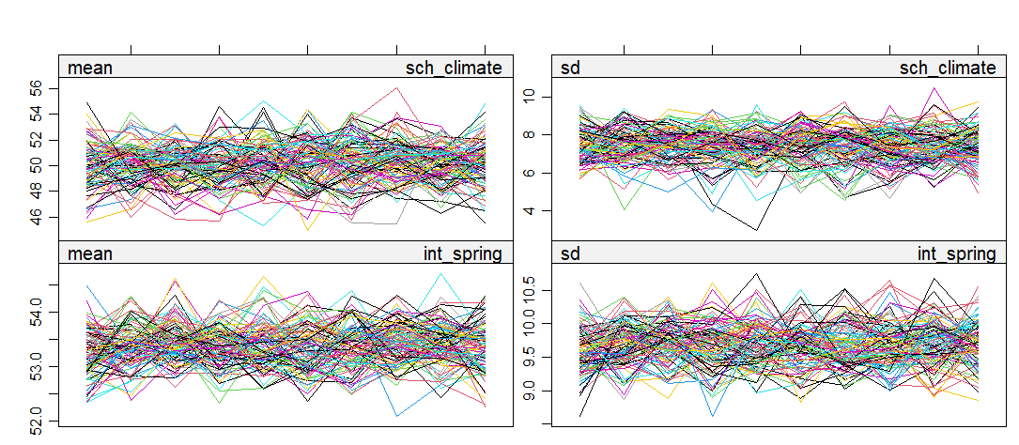
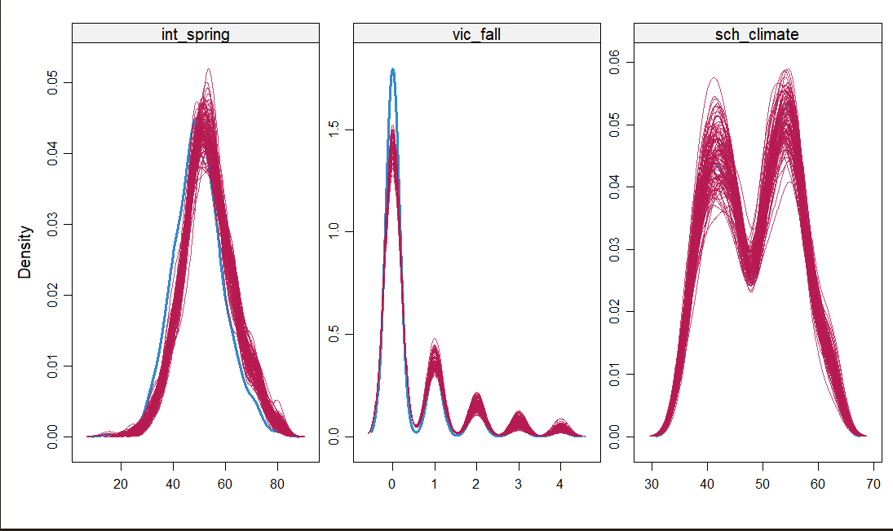
BEFORE YOU TRUST ANY OF IT
Diagnostic figures: Trace and Density Ploits
Did the process settle down?
Are the filled values plausible?
The filling procedure is iterative. Plot how the imputed values evolve across iterations and look for lines that mix together rather than drifting apart or running in parallel.
Compare the distribution of what you filled in against what you observed. They should look like they came from the same world.
We will look at both in the demonstration.
Notes:
Point forward to the demo here - it gives the second half of the session a purpose.

Slide 22
THE OBJECTION IVE HEARD IN THE PAST
"Isn’t this just making data up?"
Deleting the case is also a model. It just assumes the people who left were like the people who stayed — and it does not tell you it assumed anything.
Imputation does not invent a value
It draws from a distribution built out of everything else you know about that person — repeatedly. This uncertainty is preferable to the uncertainty of deletion.
Deletion does assert something
That the remaining sample is exchangeable with the one you started with. That is a heroic claim.
Notes:
Put this on a slide rather than waiting for the question. Audiences trust speakers who pre-empt the obvious objection.

Slide 23
THE HONEST LIMIT
What multiple imputation cannot fix
When the reason a value is missing IS the value, no amount of modelling recovers it.
0.41
0.32
0.32
what the true average was
what we observed
what imputation gave back
Example: Self-reported physical fights.
The students who fight most may be the least likely to answer the question — and nothing we measured explains that data generating process except for the physical fights measure.
This is the surveillance problem in injury prevention.
The most severe cases are the least likely to be counted. Better auxiliary variables reduce the bias. They do not remove it, and no software setting will.
Notes:
Say plainly that this variable was kept OUT of the main model on purpose. If the focal exposure were like this, the whole demonstration would collapse.

Slide 24
Clustering in Multiple Imputation

Slide 25
WHY THIS ACT EXISTS
In school mental health and injury prevention,
nesting is the default
School mental health
Students in classrooms, classrooms in schools, schools in districts. Repeated measures within child.
Injury prevention
Patients in hospitals, hospitals in regions, cases in time periods. Surveillance data with shifting denominators.
What follows
If clustering is in your analysis, it has to be in the way you handle the missing data too. Otherwise the two models disagree — and the disagreement has a direction.
Most published guidance on missing data is written for flat, unclustered datasets. Almost none of our data look like that.
Notes:
This is the framing that makes Act III feel necessary rather than like an advanced footnote.

Slide 26
THE MISMATCH
Your analysis knows about schools.
Does the way you filled the gaps?
Ignoring the nesting
Respecting the nesting
Every student treated as though they were independent of every other. Which school they attend plays no part in how their gaps get filled.
The filling model knows which school each student attends, and treats school-level measures as school-level — one value per school, not one per student.
The filling process pulls everyone toward the overall average, and the differences BETWEEN schools — the thing we are trying to measure — get smoothed away.
The between-school differences survive the process, which means your model can still find them.
Notes:
Keep this conceptual. The method names and settings are on the cheat sheet and in the demo.

Slide 27
A CONCRETE ABSURDITY
What happens to a school-level measure
Our school climate score is one number per school. It came from one survey, filled out once, by one administrator.
Ignore the nesting, and the software hands two students in the SAME school two DIFFERENT values for a quantity their school has exactly one of.
What it does to the variance
Manufactured within-school variation in a variable that has none. The between-school signal gets diluted.
What it does to your model
The clustering statistic — how much of the outcome sits between schools rather than within them — comes out wrong.
Why nobody catches it
Nothing errors. Nothing warns. The output looks completely normal.
Notes:
The "two students, one school, two values" line is the one people remember. Land it.

Slide 28
THIS IS NOT A HUNCH
What the simulation literature found
Fill the gaps without the clustering, then fit a model with it, and both the within-group and the between-group coefficients come out biased — along with their standard errors.
The damage grows with the clustering
The more of your outcome sits between clusters, the worse ignoring it becomes.
The common workarounds have costs too
Adding a dummy for every cluster overstates the clustering statistic and understates the between-group standard errors. Filling gaps separately within each cluster needs large clusters you may not have.
Only matching the two models avoids it
When the filling model has the same structure as the analysis model, the bias largely disappears.
Lüdtke, Robitzsch & Grund (2017); Grund, Lüdtke & Robitzsch (2018). Both on your reading list.
Notes:
Give the methods-strong people the citation. The FCS-versus-joint-modelling question is genuinely unsettled - say so if asked.

Slide 29
OUR TEST
Same data, same question, four ways of handling the gaps
Simulated
1,586 students
28%
15 of 60
so we know the true answer and can score every method against it
in 60 middle schools
of outcomes missing
schools never returned the climate survey
Why simulate?
With real data you never learn who was right. Here we generated the data ourselves, so the true answer is known and every method can be scored against a number we can actually check. The generator ships with the materials — you can regenerate it and check our work.
Notes:
Calibrated against published figures: victimisation prevalence from the School Crime Supplement, clustering from the school-trials ICC literature.

Slide 30
THE RESULT
Four ways of handling the same missing data
Method | Estimate | Uncertainty | How inflated | Clustering error
Complete data — the truth | 0.1665 | 0.0278 | 0% | 0%
Delete incomplete cases | 0.1580 | 0.0540 | 94% | 123%
Impute, ignoring the nesting | 0.1585 | 0.0382 | 37% | -37%
Impute, respecting the nesting | 0.1584 | 0.0362 | 30% | 11%
Look at the last column, not the second.
The four estimates are close enough that the differences between them are smaller than the uncertainty around any one of them. Only one method gets closest
Notes:
Do not oversell the estimate column. We checked across random seeds and the direction of the error moves around. The uncertainty and clustering differences are the systematic ones.

Slide 31
WHAT THE TABLE ACTUALLY SHOWS
The estimate is the least informative column
Deleting incomplete cases
Overstates the clustering badly — it dropped fifteen whole schools — and pays the biggest penalty in precision of the three.
Imputing without the nesting
Understates the clustering.
Imputing with the nesting
Recovers the clustering to within a few per cent and pays the smallest precision penalty.
If your question is about a school-level effect, the clustering IS the finding. Getting it wrong by half is not a rounding error.
Notes:
This is the intellectual payoff of the session. Slow down here and let it sit.

Slide 32
REQUIRED SLIDE
What we assumed, and what breaks
What today rests on
What breaks in practice
That missingness is explained by what we measured — untestable, and we argued for it rather than testing it
That the filling model is correctly specified
That victimisation self-report means what we think it means — floor effects and contested definitions are real and we did not model them
No survey weights. With YRBS or NSCH you must use the same weight in both models or they do not agree
The model fails to settle — usually too many auxiliary variables, or near-duplicates among them
Sparse categories cause the model to break outright
Filled values fall outside the possible range — wrong method for that variable
The clustering comes out wrong — the two models did not match
Too few clusters. Below about thirty, school-level filling is unstable
Notes:
State the assumptions honestly. Faculty accept stated assumptions; they revolt at hand-waving.

Slide 33
WHAT GOES IN THE PAPER
Reporting checklist
Percent missing by variable AND by case
The sample size you would have had under deletion
Which mechanism you assumed, and why
Which auxiliary variables, and why they qualify
How you filled the gaps, and in what software
How many times you repeated it, and why that many
Evidence the process settled
Anything you changed to make it settle
Descriptive statistics before and after
Deletion results alongside imputation results
"Multiple imputation was used to handle missing data" is not a missing-data section. The full checklist is on the back of your cheat sheet.
Notes:
This checklist is the most reusable thing from the session. Point people at it for reviewing as well as writing.

